Slide 1

Virtual Currency Exchange Platform (VCEP) A Web-based Virtual Currency Exchange for IST303 Course
Group 4:
Ahmed, Ameya, Clement, Divya

Slide 2
Milestone2.0 Outline
Introduction
Milestone 2.0 Overview
Milestone 2.0 Features
Milestone 2.0 User Stories
Sprint Planning & Iterations
Agile Method & Tasks Tracking
Project Demo and code explanation
Key successes and Failures

Slide 3

Introduction
The "Virtual Currency Exchange" project is a web-based platform for simulating the experience of trading virtual currencies, including functionalities like currency conversion, tracking currency values, and managing virtual portfolios.

Slide 4
Milestone 2.0 Overview
The Milestone 2.0 plan for the "Virtual Currency Exchange" project focuses on expanding the functionality of the platform with essential features for user interaction and management. Functionalities like currency conversion, tracking currency values, managing virtual portfolios, and User Communication Forum.

Slide 5
Application Features Overview
User Registration and Authentication
User
Dashboard
Real-time Currency Data
Transaction History
User Portfolio Management
Currency Conversion and Trading

Slide 6

Milestone 2.0 Features:
1. Transaction History:
Enable users to view the history of their transactions, including dates, amounts, and other relevant details.
2. User Portfolio Management:
Allow users to view and manage their virtual currency holdings.
3. User Communication Forum
Facilitate user interaction through a forum-like feature where users can post messages, respond, and engage with each other.

Slide 7

Milestone 2.0 User Stories
1. As a user, I want to be able to sell virtual currencies at the current market rate.
2. As a user, I want to view my transaction history to track my past activities.
3. As a user, I want to see the current value of my portfolio, so that I know the performance of my investments.
4. As a user, I want to be able to communicate with other users.

Slide 8

Milestone 2.0 Sprints
Total: 41 days (until 04/17/2024 when Milestone 2.0 is due)
Iteration 1: Transaction History and Portfolio Management
Duration: 23 days.
Iteration 2: User communication and forum
Duration: 18 days.

Slide 9
Iteration 1: Transaction History and Portfolio Management
Duration: 23 workdays
On (60% velocity) Days of actual work: 4 (Four Team Members) * 23 * 0.60 = 55 Days

Slide 10

Transaction History Features:
1. Design Database Schema for Transaction History:
2. Develop Backend API Endpoints:
3. Implement Frontend Interface:
4. Integration of Frontend and Backend:
5. Testing and Quality Assurance:

Slide 11

User Portfolio Management Features:
1. Update Database Schema for Portfolio Management:
2. Backend Services for Portfolio Management:
3. Frontend Development for Portfolio Display:
4. Portfolio Feature Integration and Testing:

Slide 12
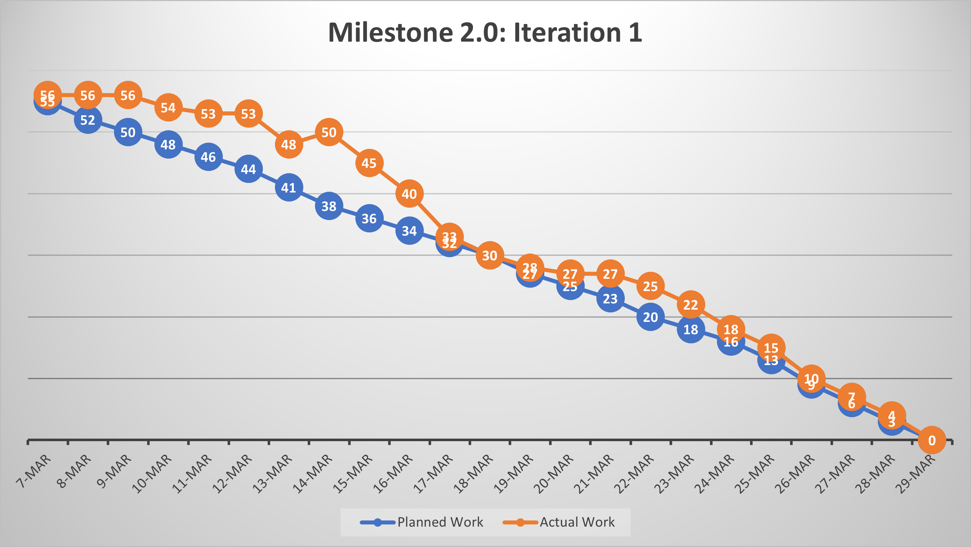
Burndown Chart iteration1

Slide 13

Iteration 2: User communication and forum
Duration: 18 workdays
On (60% velocity) Days of actual work: 4 (Four Team Members) * 18 * 0.60 = 43 Days

Slide 14

User Communication Forum Features:
1. Design Database Schema for the Forum:
2. Developing Backend for Forum Functionality:
3. Implementing User Authentication and Permissions:
4. Frontend Development for the Forum:
5. Integration of Frontend and Backend:
6. Testing and Quality Assurance for Forum Features:

Slide 15
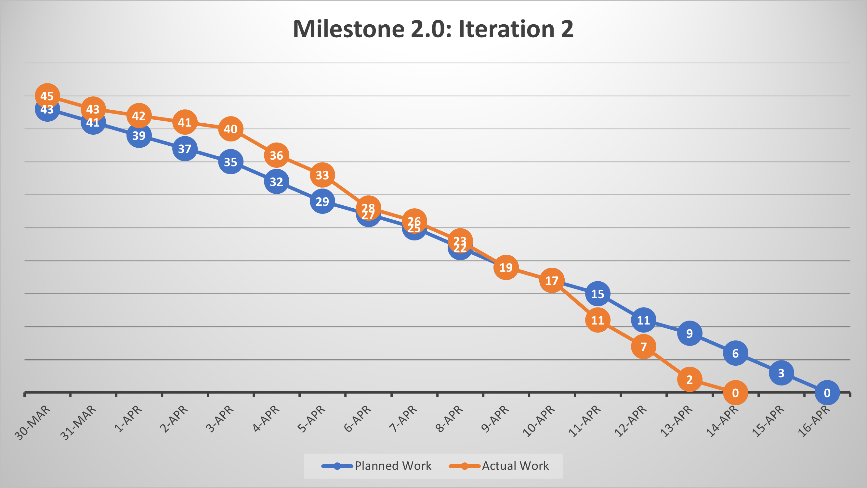
Burndown Chart iteration2

Slide 16
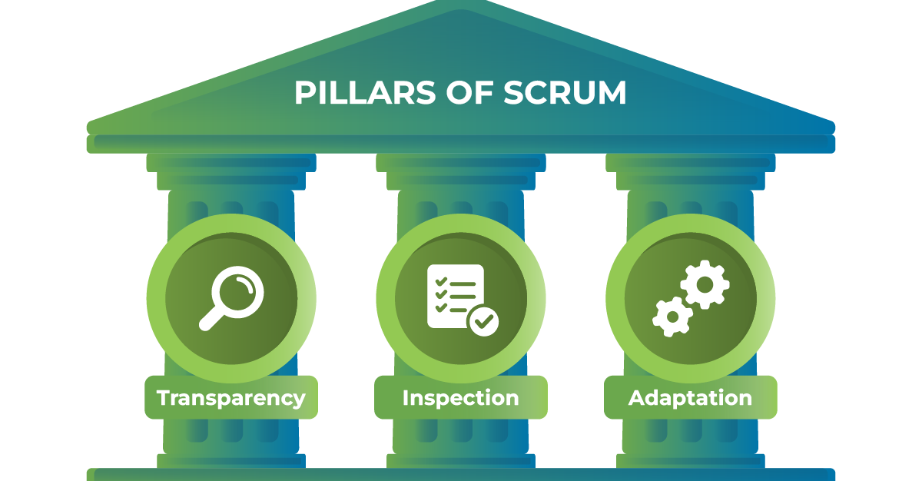
Agile Method & Tasks Tracking
Scrum framework was followed:
Firstly, the team creates a sprint goal and allocates tasks within team capacity.
The team tracks tasks using different tools.
The team meets every week to track tasks and sprint backlog.

Slide 17
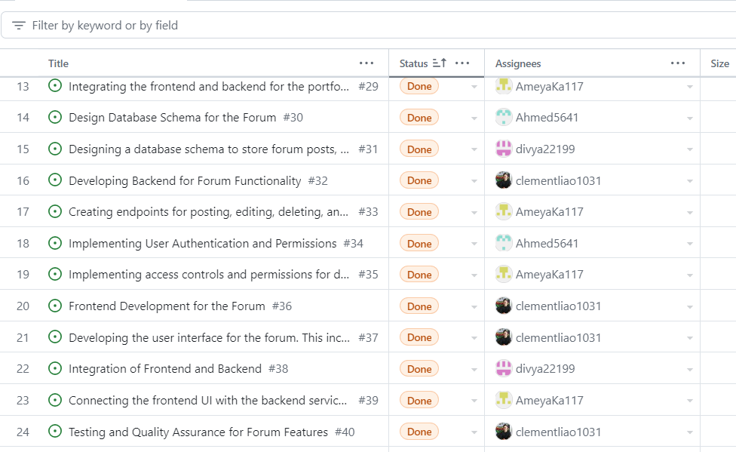
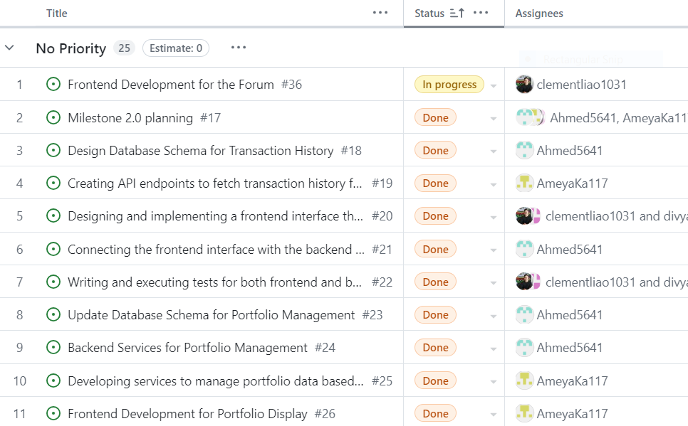
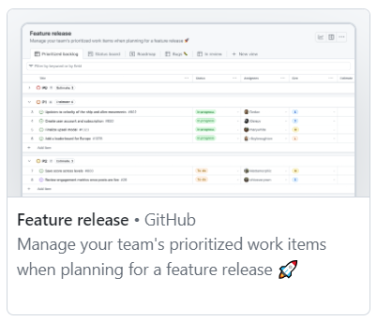
Tasks Tracking

Slide 18
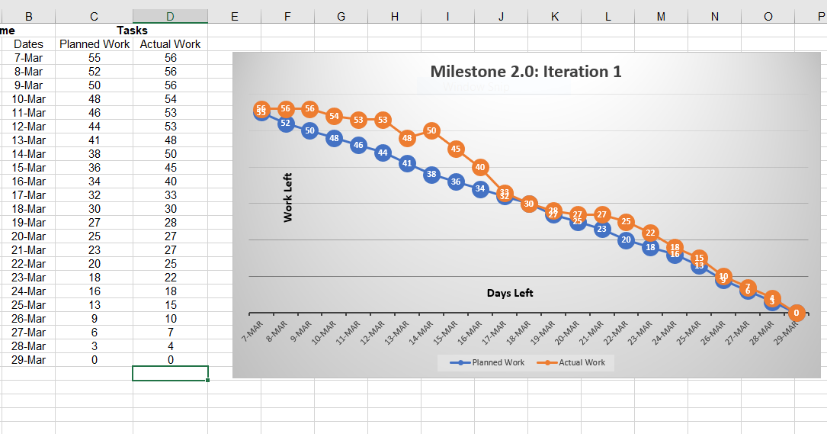
Tasks Tracking
We used burn-down charts to visually document sprint progress and facilitate discussions during Scrum events.

Slide 19
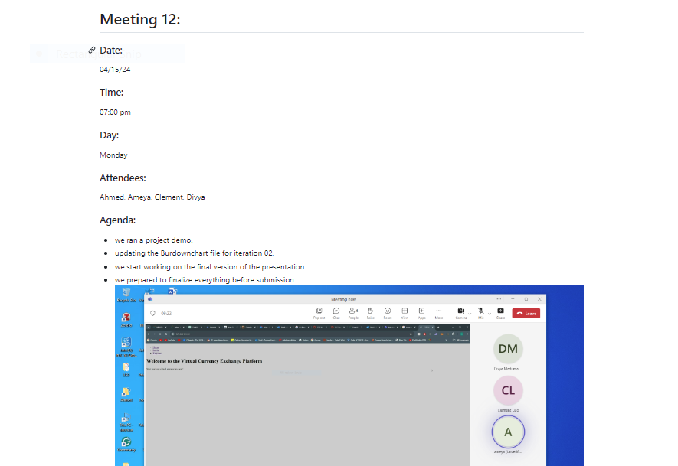
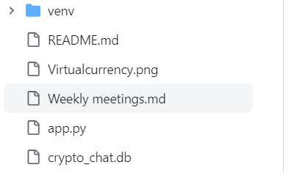
There is a folder in the project repo for all meeting records.

Slide 20

Project Demo

Slide 21

Key Successes and Failures
Successful implementation of agile Scrum that facilitated the software development process.
The effective adaptation to emerging challenges and evolving requirements.
The effective team collaboration that mitigated unforeseen challenges.
Active learning through practice for technical achievements and software development.
Better planning could mitigate tasks delay and prevent backlogs.

Slide 22

Key Successes and Failures
Some requirements have been changed due to technical difficulties.
Users’ communications and forum into a chat room functionality.

Slide 23
Presentation End
Thank you

